Slide 1

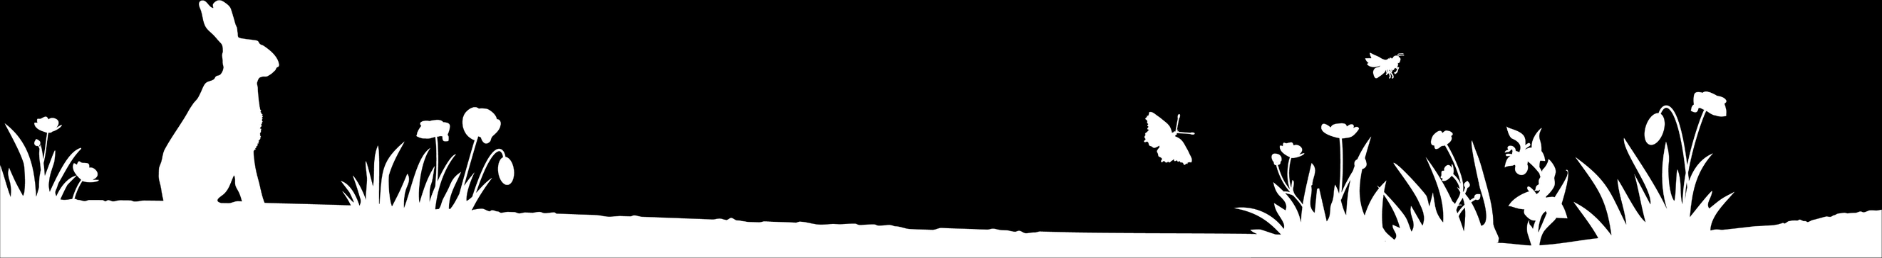
100ᵗʰ Birthday Celebration Assembly Pack

Slide 2

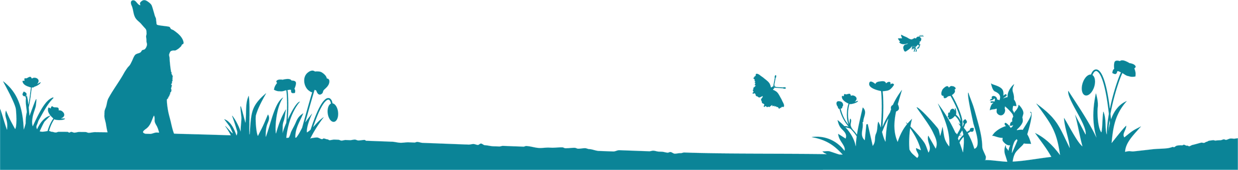
How to use this pack
  This pack includes slides, a script and links to The Wildlife Trusts 100ᵗʰ Birthday competition.
  The script is included in the notes and has also been sent as a separate PDF document. The pack is designed to be used to celebrate Sir David's 100th Birthday. It does not have to be used on his birthday but close to it would be helpful.
Notes:
Slide Three: Guess Who? Clues
Script: Clue number one — this person is a naturalist.
Does anyone know what a naturalist is?
[Take responses and confirm meaning.]
Are we any closer to guessing who it might be?
Clue number two — they are famous for making television documentaries.
Can anyone tell me what a television documentary is?
[Take responses.]
So, we’re thinking of someone who is a naturalist, makes TV documentaries, and is turning 100.
If you think you know, put your hand up — but don’t say the name just yet!
Let’s look at some more clues.
They love exploring different countries and make programmes about wildlife and plants all over the world.
And our final clue…
They encourage people to make positive changes to help the natural world.
Turn to the person next to you and quietly whisper who you think it might be.
[Allow brief discussion.]
Let’s find out if we were right.
[Optional drum roll by tapping hands on knees.]
2

Slide 3
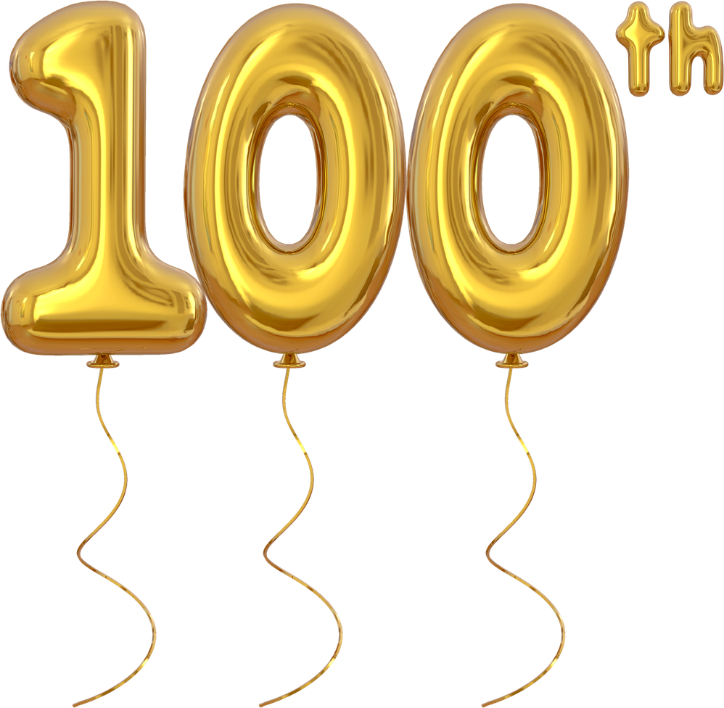
Notes:
Slide Two: Opening & Introduction
[Show slide while pupils enter the hall. You may wish to play suitable welcome music.]
Script: We are gathered here today to celebrate the 100th birthday of someone very special — not just to the UK, but to the whole world. I wonder who it might be? Take a quiet moment to think about whose 100th birthday has been celebrated recently.
[Pause to allow pupils time to think.]
Would anyone like to share who they think it might be?
[Listen to pupils’ suggestions but do not confirm any answers yet.]
Those are some great ideas. Let’s look at some clues to see if we’re getting closer.
3

Slide 4
Whose birthday is it?
Some clues to help…
  They are a naturalist.
  They are known for their television documentaries.
  They love to explore different countries.
  They make documentaries about wildlife and plants all over the world.
  They encourage us to make positive changes for the natural world.
Notes:
Slide Three: Guess Who? Clues
Script: Clue number one — this person is a naturalist.
Does anyone know what a naturalist is?
[Take responses and confirm meaning.]
Are we any closer to guessing who it might be?
Clue number two — they are famous for making television documentaries.
Can anyone tell me what a television documentary is?
[Take responses.]
So, we’re thinking of someone who is a naturalist, makes TV documentaries, and is turning 100.
If you think you know, put your hand up — but don’t say the name just yet!
Let’s look at some more clues.
They love exploring different countries and make programmes about wildlife and plants all over the world.
And our final clue…
They encourage people to make positive changes to help the natural world.
Turn to the person next to you and quietly whisper who you think it might be.
[Allow brief discussion.]
Let’s find out if we were right.
[Optional drum roll by tapping hands on knees.]
4

Slide 5
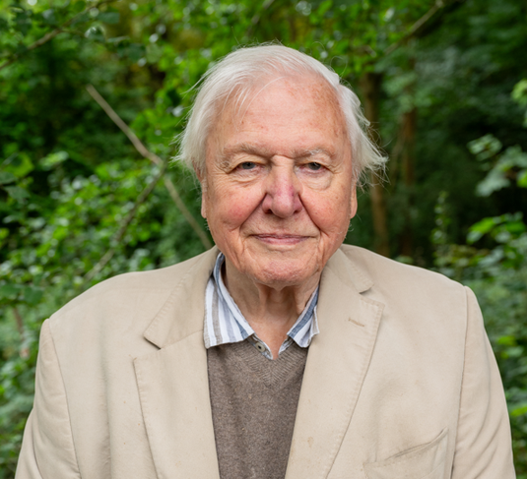
Picture of Sir David Attenborough
Sir David Attenborough is 100!
Friday 8ᵗʰ May 2026.
Notes:
Slide Four: Reveal
Script: You guessed correctly — it is Sir David Attenborough, who turned 100 on Friday 8th May 2026. How many of you have watched a David Attenborough documentary before?
Let’s watch a short clip now. You might recognise his voice, even if you don’t recognise the programme.
[Play an age‑appropriate clip.]
5

Slide 6
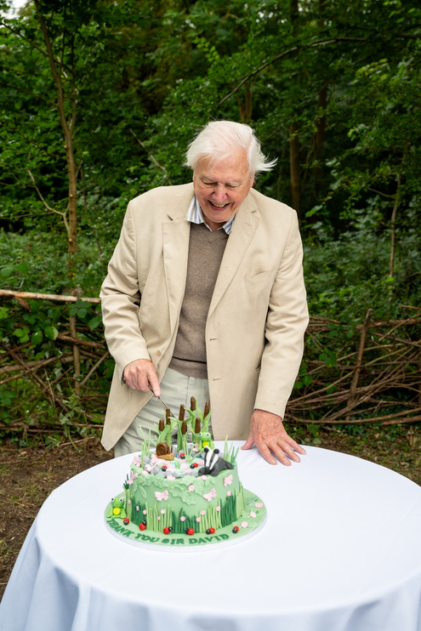
In our assembly today we are learning about:
  The life and work of Sir David Attenborough.
  Why his message is important.
  Green Promise competition to honour Sir David
  Attenborough’s 100ᵗʰ Birthday.
  This assembly links to the values of
  Wisdom Courage Hope
©Broni Lloyd-Edwards
Notes:
Slide Five: What we will learn
Script: Today, we are learning about:
The life and work of Sir David Attenborough
Why his message about nature is so important
The Wildlife Trusts Green Promise competition, created to celebrate his 100th birthday.
Our assembly also links to the values of wisdom, courage, and hope.
[Adapt values if needed.]
Sir David was born 100 years ago.
Can anyone work out what his date of birth would be?
[Take responses.]
Script: Sir David was born 100 years ago. Can anyone tell me what his date of birth would be? [Take responses from the pupils.]
6

Slide 7
David Attenborough was born on the 8ᵗʰ May 1926 in London.
He grew up in Leicestershire, with his mother, father and two brothers.
David loved to explore the countryside on his bike.
Hunted for newts for the Zoology department at the
University where his Dad worked.
He particularly liked to hunt for fossils.
Notes:
Slide Six: Early Life & Curiosity
Script:
Sir David Attenborough was born in Isleworth, London. His mother was Mary, his father was Frederick, and he had two brothers — Richard and John.
When David was five, his family moved to Leicester, where his father worked at the university. The family lived on the university campus.
As a young boy, David loved to explore. He often rode into the countryside, looking at plants, animals, and hunting for fossils.
He even went pond dipping to find newts. The University of Leicester’s zoology department once paid him three pence per newt!
Fossil hunting was another passion. He used a hammer to break open rocks and often found ammonites. Does anyone know what an ammonite is?
An ammonite is an extinct sea creature, and we find fossils of their shells today. David loved thinking that he might be the first person to see that creature in millions of years.
All of these adventures helped grow his curiosity about the natural world.
7

Slide 8
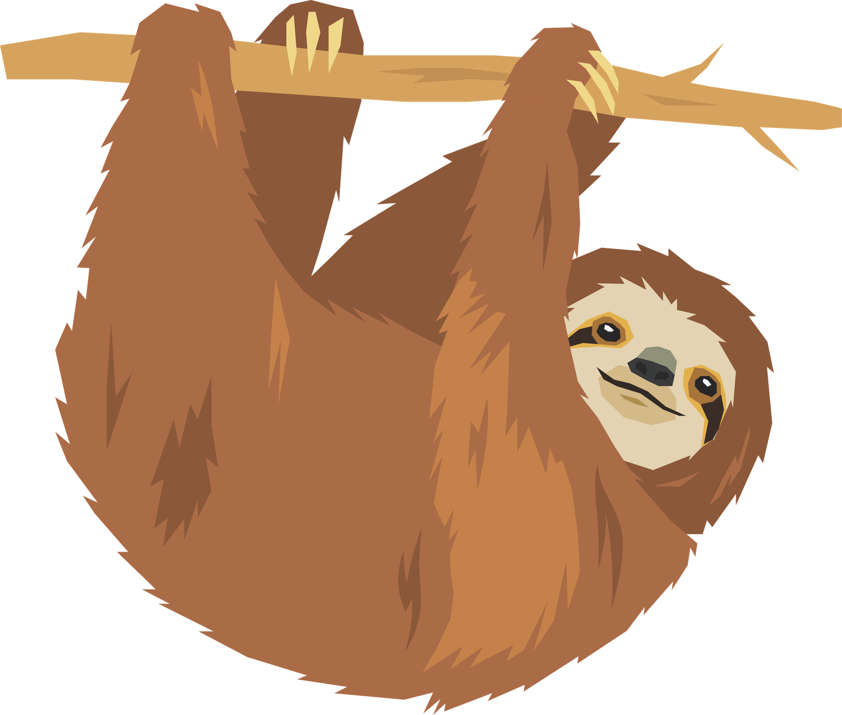
Sir David Attenborough's career:
  Studied natural sciences at Cambridge University.
  Completed national service in the Royal Navy.
  Producer for the BBC.
  Began to make natural history programmes.
  Zoo Quest – this was the start of his natural history documentaries.
  Career has spanned 70 years – has made over 100 documentaries (producer, presenter, writer, narrator) focused on natural history, wildlife and cultures of different countries.
  Written 29 books.
  Sir David Attenborough has connected millions of people to nature – shown them wildlife and places they may never expect to see.
Notes:
Slide Seven: Career & impact
Script:
Sir David’s career has lasted over 70 years. He studied Natural Sciences at university and completed his national service in the Royal Navy. In the 1950s, he began working for the BBC, when television was only black and white. One of his first programmes was called Zoo Quest. Later, when television became colour, Sir David decided people should see animals in their natural habitats. That’s when he moved in front of the camera and began making wildlife documentaries.
He has now made over 100 documentaries, showing people animals and places they could only dream of seeing — from whales and penguins to gorillas and sloths.
Through his work, millions of people have learned to love and care about nature.
8

Slide 9
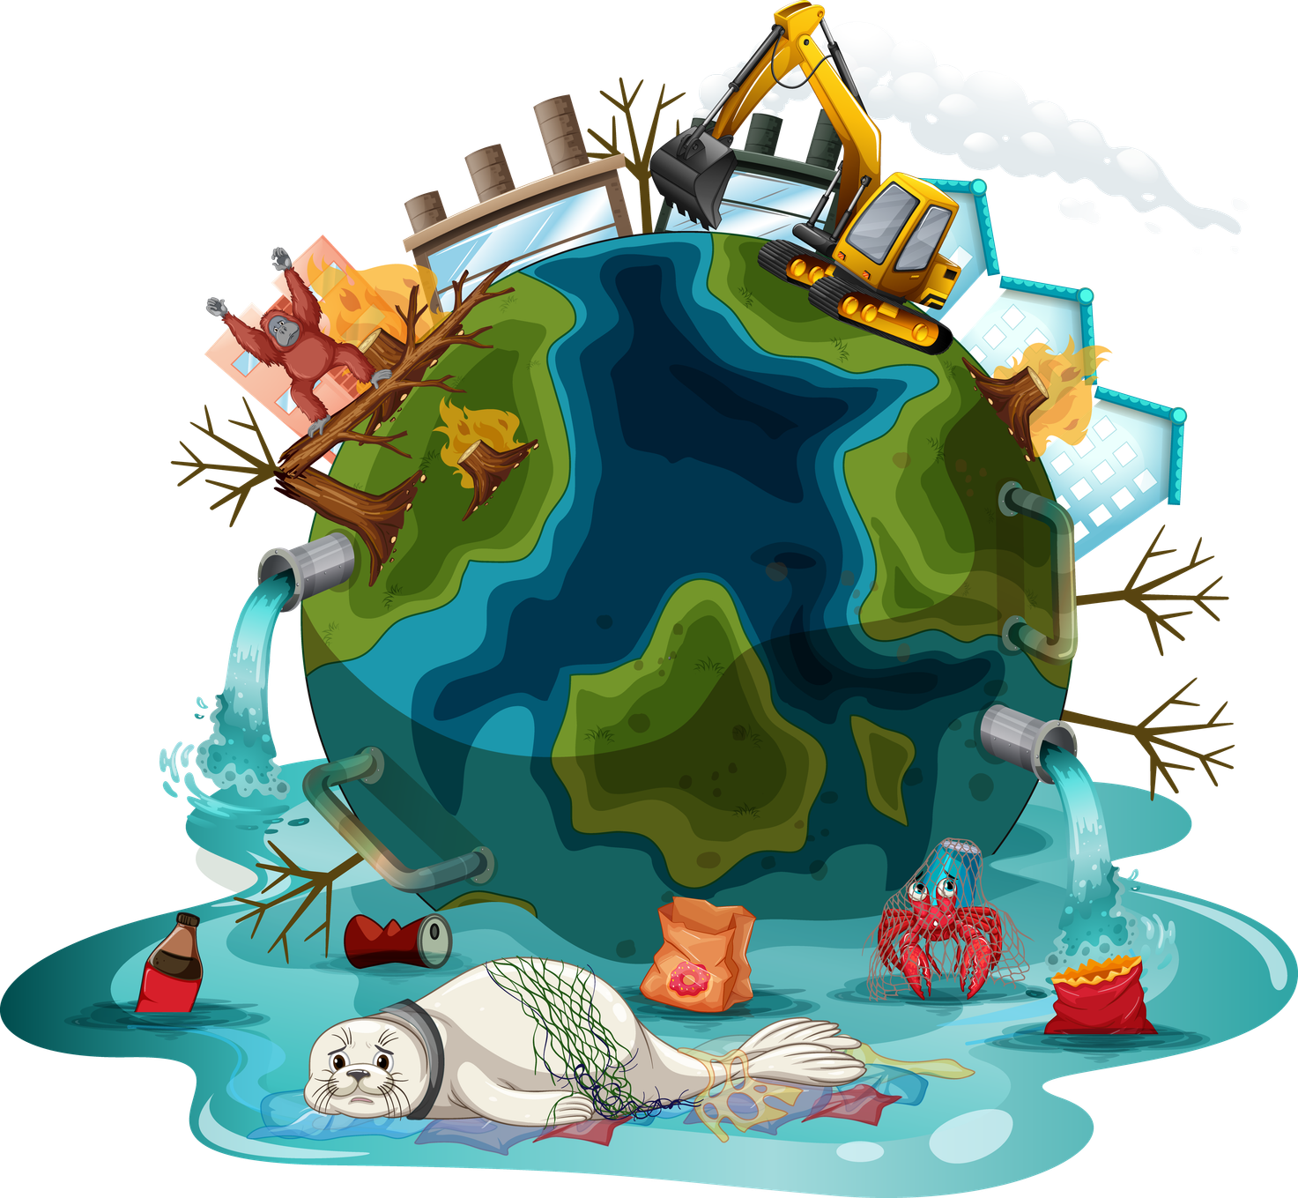
Over time, David noticed several things and became very concerned...
  The amount of wild space has become much less.
  More animals are in danger of extinction as their habitats are being taken over by humans.
  There is more carbon being released into the atmosphere through the way we live our lives.
  The earth is becoming warmer and heating up which is causing more extreme weather events and patterns.
  David realised...
“What’s happens next… is up to us”
Notes:
Slide Eight: Growing concerns & hope
Script: Over time, Sir David noticed worrying changes in the world. Wild places were shrinking, animals were losing their homes, and pollution was causing the planet to warm.
He realised that if humans didn’t change how we live, it would become harder for both people and animals to survive.
But Sir David also believes there is hope. He believes we can change what happens next — if we act for nature.
9

Slide 10
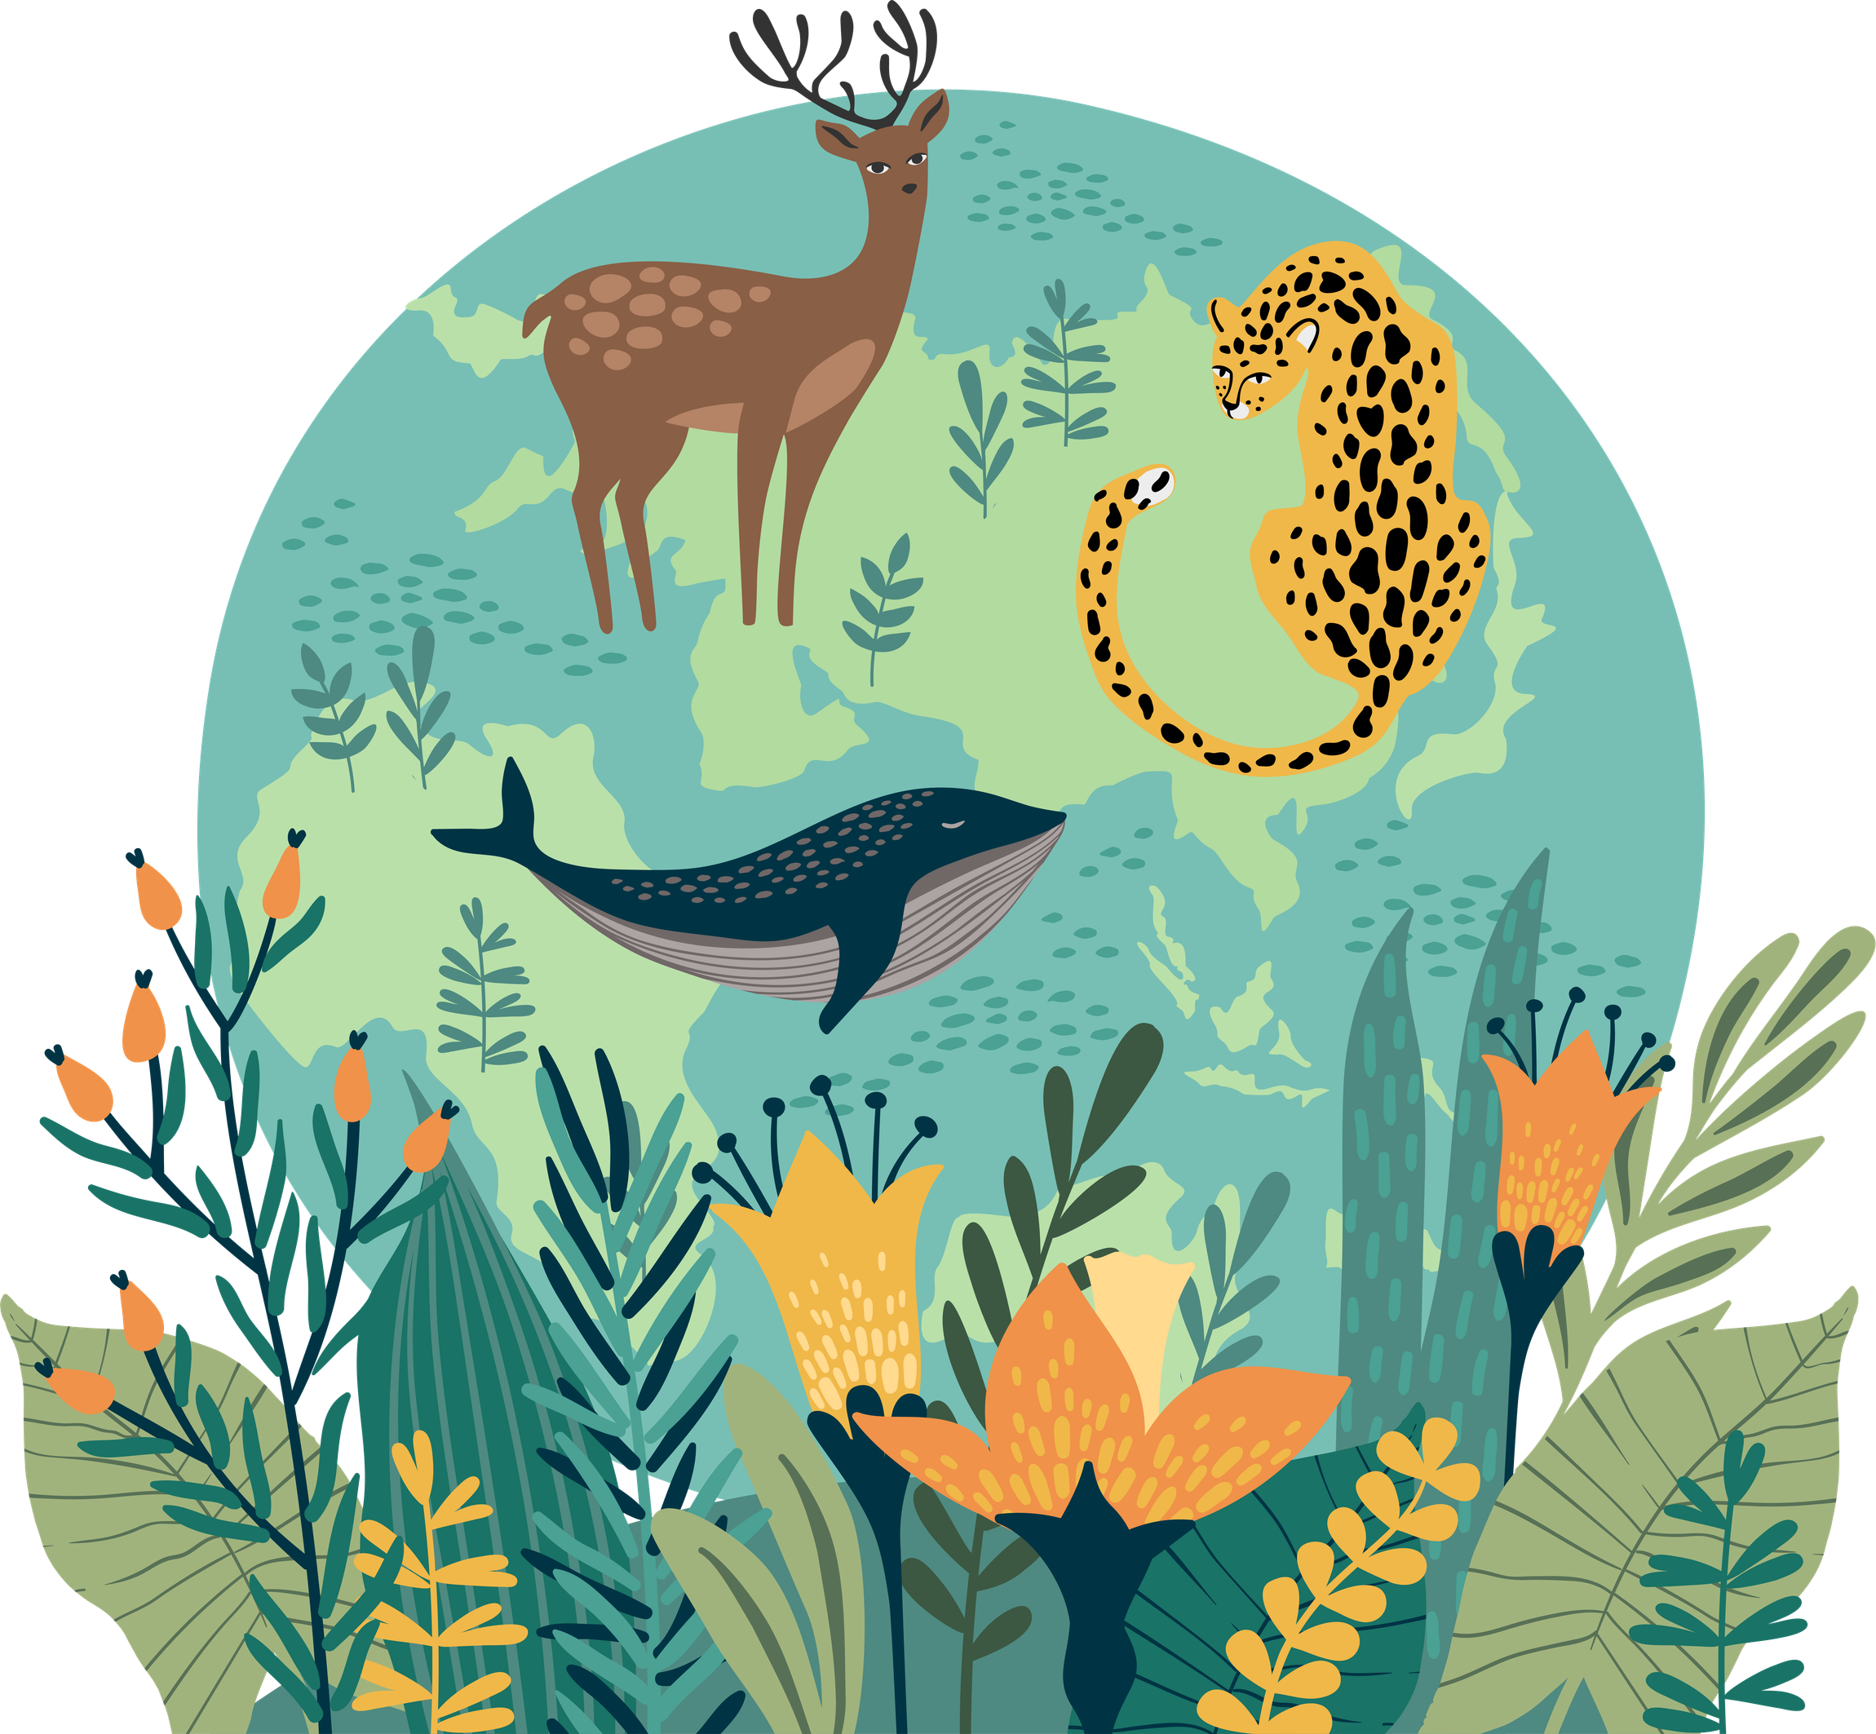
We must rewild the world. If we act now, we can yet put it right
If we have no fishing zones in the oceans, sea life will have time to recover and grow."
We will have to use new ways to get the energy we need – from the sun, the wind and our powerful rivers and tides."
If we eat less meat, there will be more land for wild places."
There is hope, that if we work together and act for nature, we can heal the planet.
If we eat less meat, there will be more land for wild places."
We need our forests to clean the air and provide a home to more wild animals.
If we eat less meat, there will be more land for wild places."
Notes:
Slide Nine: A Life on Our Planet
Script: Sir David made a film, and book called A Life on Our Planet. In it, he explains what changes we need to make so people and nature can live in balance.
[Read selected quotes from the slide and discuss.]
Sir David believes that by working together, we can heal our planet.
So… what can we do?
10

Slide 11
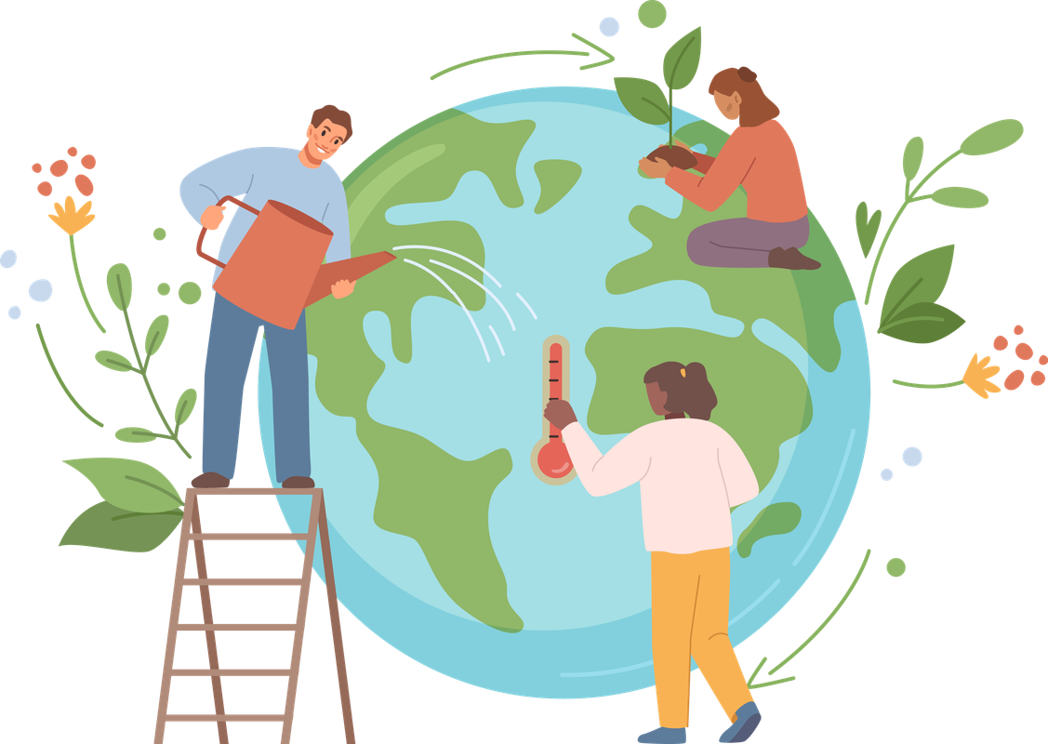
Green Promise Competition
Commit to positive, practical action for nature to celebrate Sir David's centenary
Create a short action plan outlining your Green Promise. This should clearly explain:
  what the promise is,
  why it is important, and
  how you plan to deliver it.
Action plans need to ...
  Explain how nature is protected or helped
  Involve a community of people
  Help build a meaningful connection with nature.
Action plans need to be presented creatively – they could be a short film, photo board, comic strip, leaflet or similar.
Notes:
Slide Ten: Green Promise Competition
Script: XXX Wildlife Trust has invited us to take part in their Green Promise competition to celebrate Sir David’s 100th birthday.
Who can tell me what a promise is?
[Take 1–2 responses.]
A Green Promise is a promise to take positive action to help nature.
To enter, we need to create a plan explaining:
What our promise is
Why it is important
How we will keep it
Our promise must help nature, involve other people, and help us learn and care more about the natural world.
11

Slide 12
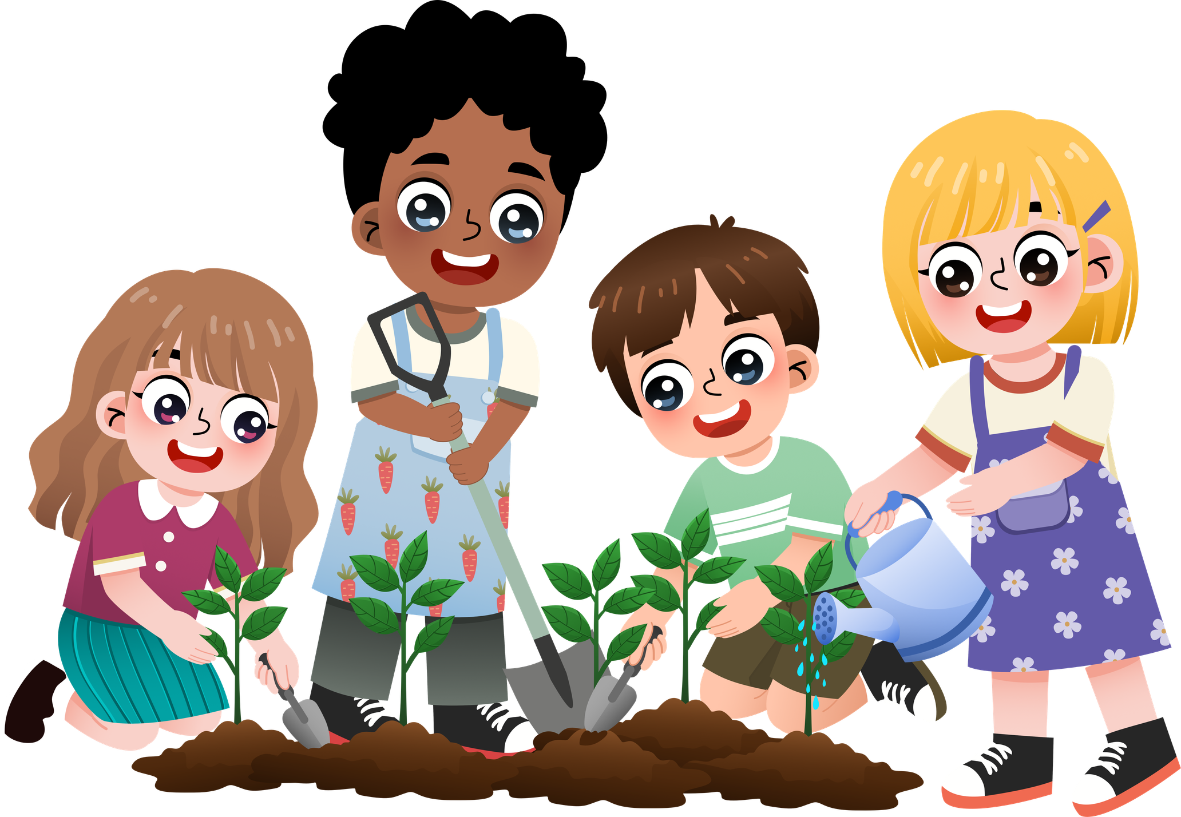
Entries will be judged on:
  the sustainability of the promise (can it continue over time?),
  why you have chosen that particular conservation action,
  how it encourages groups of people to work together (both inside and outside of school) to help nature
  how helps people to learn about and care for nature
  We will also be looking for evidence that you have begun to start your action plan and keep your green promise.
  Entries need to be sent into Herefordshire wildlife trust by 31st July 2026
Notes:
Slide Eleven: Judging
Script: Now that we know what a Green Promise is, let’s talk about how your amazing ideas will be judged.
The people at XXX Wildlife Trust want to understand your promise, so they’ll be looking for a few important things.
First, they want to see if your promise is sustainable.
That means asking: Can this promise keep going for a long time?
For example, is it something you can do again and again, not just once? A good green promise helps nature now and in the future.
Next, they want to know why you chose your conservation action. What made you pick this idea? Is it because you noticed something near your school or home that needs help?
Or maybe it’s something you care about, like animals, plants, or habitats. There’s no wrong answer – they just want to know what matters to you.
Another important thing they are looking for is teamwork.
Your green promise should encourage groups of people to work together. This could be people in your school – like your class, teachers, or school council – and also people outside of school, such as families, neighbours, or the local community.
Working together helps us make an even bigger difference for nature.
They also want to see how your promise helps people learn about and care for nature.
Does your idea teach others something new about wildlife, plants, or the environment? Does it help people understand why nature is important and how we can look after it? Learning is a big step towards caring.
Finally, they will be looking for evidence that you have already started. This means showing that you’ve begun your action plan and are keeping your green promise. You might have photos, posters, notes, videos, or drawings to show what you’ve done so far. Even small steps are important – what matters is that you’ve started.
Remember, all entries need to be sent to XXX Wildlife Trust by the 31st of July 2026. That might feel like a long way away, but it’s a great idea to start as soon as you can.
12

Slide 13
Prizes
1st Prize - £200 Muddy Faces Vouchers
2nd Prize - £100 Muddy Faces Vouchers
3rd Prize - £50 Muddy Faces Vouchers
Winning entries from each Wildlife Trust will be compiled into a short presentation and shared with Sir David Attenborough.
Notes:
Slide Twelve: Prizes
Script: Now for the exciting part… let’s talk about what we could win! Everyone who takes part is helping nature, which is amazing all by itself. But there are also some fantastic prizes up for grabs!
The first prize is £200 in Muddy Faces vouchers for the school.
That’s a lot of vouchers we could use for outdoor equipment, nature tools, or fun learning resources.
The second prize is £100 in Muddy Faces vouchers. That’s still a brilliant prize to help us keep exploring and enjoying the outdoors.
And the third prize is £50 in Muddy Faces vouchers. A great reward for working hard and helping nature. But that’s not all!
Winning entries from each Wildlife Trust will be put together into a special short presentation. And guess who will get to see it? That’s right — Sir David Attenborough himself!
Your ideas, your promises, and your hard work could be shared with one of the most famous nature lovers in the world. So, remember — every promise you make, every action you take, and every idea you share really matters.
You could win a prize, help nature, and inspire Sir David Attenborough!
13

Slide 14
Example Green Promise:
Our green promise is to make our school hedgehog friendly. We know this is important as hedgehogs are now endangered and they need our help to protect their habitats.
The whole school are working together to help hedgehogs. Each class is taking a different action. Hazel class are leaving out water. Oak class are leaving out food. Beech class are completing litter picks. Sycamore class are checking the football nets each day. Ash class are building log piles and marking out a long grass area.
Each class are making a leaflet or poster to share our actions with the village and encourage others to help.
We are sending to Hereford Wildlife Trust photographs of pupils taking action for
hedgehogs, copies of community leaflets, and a poster outlining the full action plan.
Notes:
Slide Thirteen: Example Action Plan
Script: This is an example of a green promise, which may help us think about our promise. Let’s read through the slide to see if it helps us think more about our promise. [Read through the example on the slide.]
14

Slide 15
Can we think of some ideas for our Green Promise entry?
Notes:
Slide Fourteen: Ideas
Script: Now it is our turn to think about a green promise we can make. I am going to give you a little bit of thinking time and then we can collect some ideas. [Allow children some time to think and then ask them to share their ideas. You can record initial ideas on the slide.]
Script: That’s a great start – well done. We will now need to work together in our classes/year groups [adapt as appropriate] to develop our action plans. I can’t wait to see what you come up with.
15

Slide 16
Reflection:
Let us be grateful for the beauty and wonder of nature; all the wonderfully wild places, plants and animals.
Let us be more like Sir David Attenborough – use him and his wisdom as inspiration for making positive choices to act for nature and restore the wild.
Let us think wisely and creatively, to work together as a community, to make a thoughtful, inspired Green Promise.
Our Green Promise is your chance to help nature, work together, and make a real difference to the world.
Notes:
Slide Fifteen: Final Reflection
Script: We are now going to come together for a final reflection to finish our assembly. Close your eyes and have some thinking time about Sir David Attenborough’s inspiring life and wisdom as well as what we could do for our green promise. [Read through the reflection on the slide.]
16

Slide 17
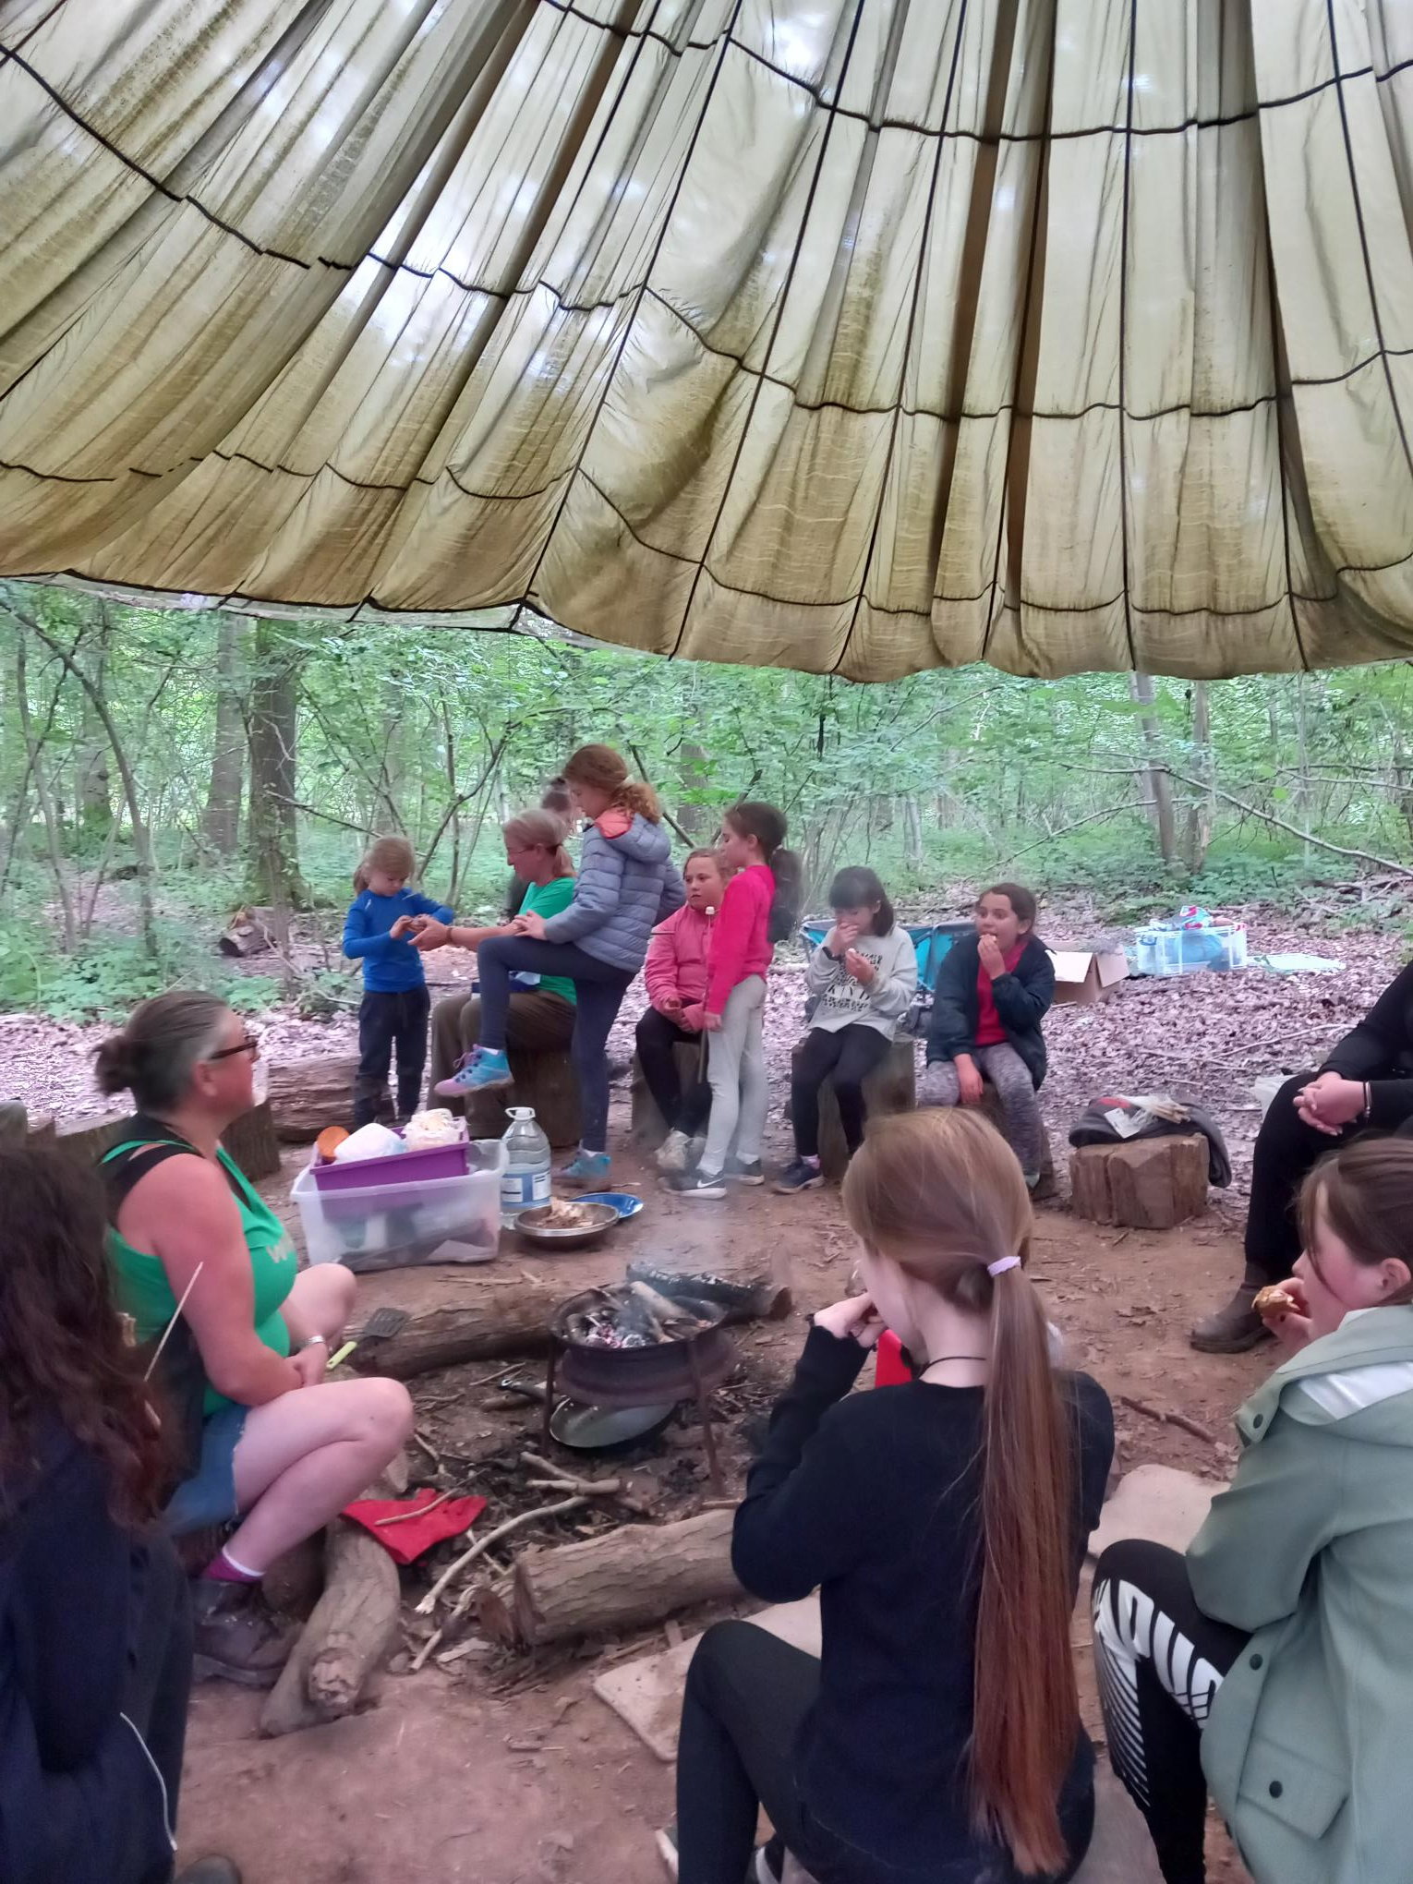
School visits to Queenswood, Herefordshire
A superb outdoor classroom setting
If you tell us you’re coming, we will provide the following for FREE to enhance your visit.
Introductory talk about Queenswood and Herefordshire Wildlife Trust
Queenswood Adventure Passport for each visiting child to take away
seasonal activity sheet via e-mail to support learning on the day
Free coach/minibus parking
Woodland Workshops
Our Woodland Workshops are for KS1 and KS2 groups, based on a maximum class size of 32. Our team has a wealth of nature knowledge and playworker wisdom. We have combined our passion for wildlife and playful outdoor experiences to create seasonal sessions to deliver in the woods, all year round!
Prior booking is essential. Woodland Workshops are £150, based on a maximum class size of 32 children, KS1 and KS2.
"I think the session was amazing and both Vic and Rosa were brilliant with the children. They adapted the session well for the cohort and there was a really good mixture of adult led and child-initiated learning. My class were fully engrossed throughout the session and there were plenty of proud moments along the way – sparking a fire, toasting marshmallows, building dens and exploring the wild. Loved it!

Slide 18
References:
Websites:
Sir David Attenborough – key moments in his career so far - Discover Wildlife
Who is Sir David Attenborough? Everything you need to know about the nature broadcaster and cultural icon | Countryfile.com
David Attenborough - Wikipedia
Journey from humble roots to national stardom with David Attenborough's family tree | Blog | Findmypast.com
Sir David Attenborough Timeline 1926-Present Day
Film:
David Attenborough: A life on our planet (2020) Directed by Jonnie Hughes, produced by Silverback Films, WWF
Books:
Rocco H & Rocco J (2024) Wild Planet: The inspiring life and wisdom of Sir David Attenborough; Rock the Boat
Attenborough, D (2022) A life on our planet: my witness statement and vision for the future; Hachette Book Group, Inc.

